Slide 1


DS4A Team 74 project
EPM Asset Interventions

Slide 2
Business problem
EPM s a domiciliary public services company providing energy, water, sewage and natural gas utilities in 123 municipalities of Antioquia
Maintenance activities are carried out frequently on their physical assets. The details of these activities are stored in free-text work orders
EPM wants to understand better the maintenance history, frequent problems and corrective actions undertaken in their assets in order to devise effective preventive maintenance strategies

Slide 3



Datasets
Work orders
Assets
Relations
Text files with work orders registries (old system)
Excel table containing more structured data on problem classification and html worklogs (new system)
Table containing identification data for each asset
Tables containing asset problem classification, hierarchy of anomaly codes, complementary data on work orders registered using the old system

Slide 4
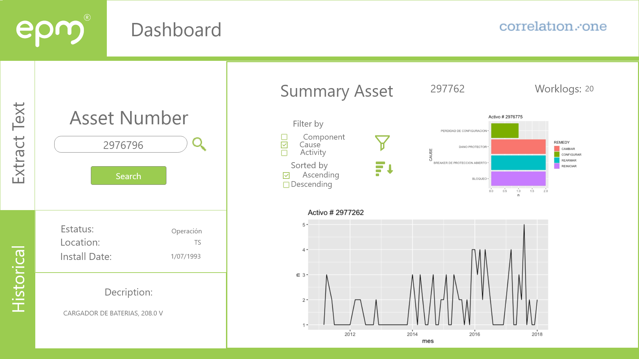
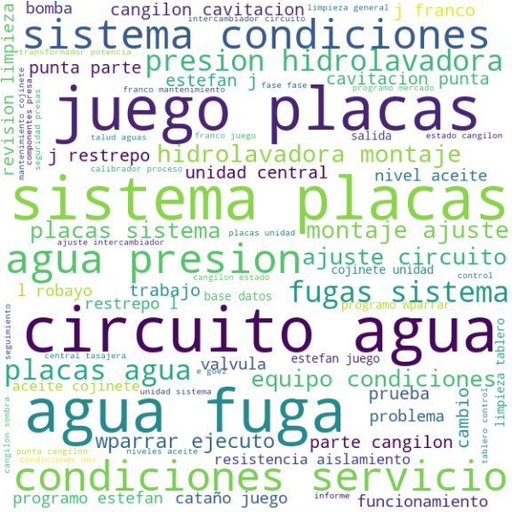
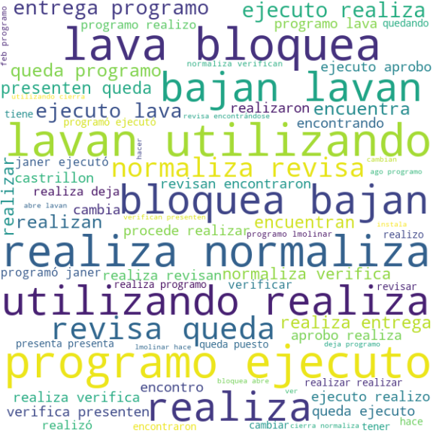
Methods and interface
The main challenge with this dataset is to extract meaningful insights from free-text files
Natural Language Processing (NLP) algorithms are necessary to get keywords and relationships from the provided dataset
Work orders issued using the new system have additional tags that can be used to classify them more easily. Supervised ML algorithms can be explored to label work orders issued using the old system
We expect to deliver a platform in which data from each asset can be queried and displayed easily, with relevant insights obtained from all work orders

